Slide 1

A DEEP-DIVE INTO THE ECOMMERCE-WORLD
BA775 B04
Ahmed Farid Khan, Jishnu Moorthy, Lyushen Song,
Jiayi Huang, Qianyi Mo, Xinyuan Hu

Slide 2


theLook
theLook is a fictitious eCommerce clothing website facing key operational challenges.
Seeking detailed insights into organizational challenges that theLook is facing.
Data source from BigQuery Public Data. Access here.
Notes:
introduce our client

Slide 3

PROBLEM DEFINITION
Low Inventory Turnover Rate
Inefficiencies in their supply chain
Indicating theLook is taking a longer time to sell inventory and replace with new stock.
Low Customer Retention Rate
But high growth rate
theLook is doing well in attracting new customers, but not so good at retaining them.
Notes:
More reasons behind will be revealed by further analysis shown later.

Slide 4
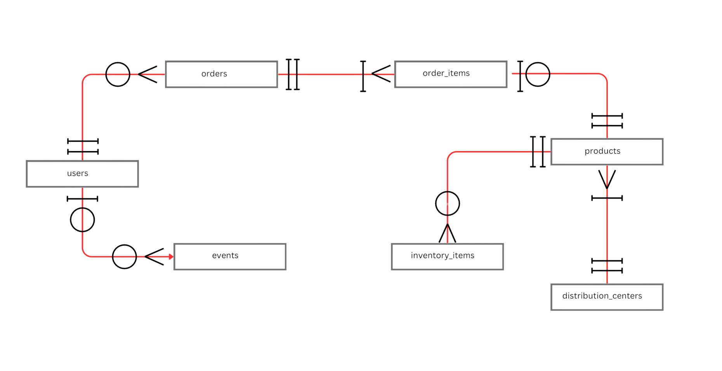
ERD

Slide 5

HOW WE HELPED
SQL
Data retrieval and management
Data analysis
Tableau
Visualize the data
Data-Driven Business Recommendations
Notes:
how we use sql and tableau to our data to generate business insights
-> recommendations

Slide 6

DASHBOARD
1.Overview Dashboard
2.Country Specific Dashboard
Notes:
QR code

Slide 7

CONCLUSIONS
Extremely Low Inventory Turnover Rate
Significant decline in inventory turnover after first year
Overstocking and supply chain inefficiencies
Struggles in Retention rate
High growth but low customer retention
Challenges in maintaining customer loyalty
Loss making business
Significant losses in few years due to low inventory turnover
Notes:
Two slides - follow the structure on the notebook

Slide 8

CONCLUSIONS
Consistently Increasing Sales
2019 (168,000) till now (3,800,000)
Customer Lifetime Value
High CLV ($1037) for theLook
Enhance it through improved retention strategies
Geographic Concentrations
USA, China, and Brasil
Potential for expansion into South Korea
Traffic Channels
Email

Slide 9
RECOMMENDATIONS
Liquidating excess inventory in the short run
Improving inventory management in the medium long run
Figuring out why customers are not being retained
Strategizing retention based on findings
Localizing marketing and product offerings
Expanding marketing strategies

Slide 10

CHALLENGES
Nature of Fictitious Dataset
Procedurally Generated Dataset
Unusual Inventory Patterns
Daily Updates of Dataset
Missing some available data during the project
Notes:
One of the challenges we faced was the nature of our dataset. It is a fictitious dataset that is procedurally generated by Google. This has obvious advantages such as the assured cleanliness of the data. However, it presents challenges that we did not foresee. Due to the nature of the programmed sales, there are patterns that just do not make sense. For example, 63% of the items in inventory have not been sold. This is incredibly high for a normal eCommerce store. However, it is possible that the team behind theLook keeps a very high inventory level so that there are no bugs in the code. An inventory analysis would have been much more interesting if the team behind theLook had thought about this issue for analysts ahead of time.
Another challenge that we faced was the daily updates of the dataset. We were working with live data up until the submission of the first assignment. Before submitting that, we saved tables for information up to 24th November. So, we were able to solve that problem, but this means we are missing some available data from the last two weeks.

Slide 11
THANK YOU
Questions?

